Slide 2
CONTENTS OF THIS
NGB SOCIAL ACTIVATION TOOLKIT
Here’s what you’ll find in this World Lacrosse Sixes toolkit/template slides:
A Social Media Strategy/Timeline for the May 18th Launch
A slide structure based on a WL Sixes Social Media strategy, which you can easily adapt and customize to your needs. For more info on how to edit the template, please visit WL Sixes Brand & Communications Guidelines
An assortment of graphic resources that are suitable for use in the presentation can be found at the end of the slideshow
A selection of Avatar slides, where you’ll find a blank Avatar template you can edit and fill with custom colors.
A selection of Social Media Frame slides, where you’ll find examples and blank Frame Templates you can edit for your NGB/program needs.
A Social Media infographic describing World Lacrosse Sixes and how to play it
Final slides with: additional assets and contact information for any questions!

Slide 3
TABLE OF CONTENTS
01.
02.
SIXES SOCIAL
STRATEGY
WL SIXES LOGOS
Next steps &
call to action
Additional access to the Sixes Logos
03.
04.
AVATARS
FRAMES
Here you can customize avatars
Here you can customize social media frames
05.
06.
INFOGRAPHICS
ASSET LINKS
Access Sixes Infographics
Sixes Brand Assets (website links/info)

Slide 4
SOCIAL STRATEGY/TIMELINE
MAY
10
10:00 (US-MST)
Sixes Brand Assets released to NGB’s (this is not public yet, please keep internal)
10:00 (US-MST)
MAY
18
World Lacrosse Sixes Brand Launch (Public)
NGB Game Plan:
Post your custom Avatar or Frames with #worldlacrossesixes
Tag/Follow our NEW Social channels (handles to be revealed on 5/17)
Have fun with World Lacrosse Sixes on your social platforms!

Slide 5
WL SIXES LOGOS

Slide 6
WL SIXES AVATARS

Slide 7
WL SIXES AVATAR
HOW TO CUSTOMIZE
ON Google Slides or Powerpoint:
File > Download > JPG image > Current slide
Need an .eps or .svg file? See the end of the presentation for all file templates
Need World Lacrosse to colorize your Avatar:
Email your request and color palette to amastera@worldlacrosse.sport

Slide 8
WL SIXES
SOCIAL FRAMES

Slide 9
WL SIXES
SOCIAL FRAMES

Slide 10
WL SIXES
SOCIAL FRAMES

Slide 11
WL SIXES
INFOGRAPHICS

Slide 12
WL SIXES
INFOGRAPHICS

Slide 13
WL SIXES
INFOGRAPHICS

Slide 14
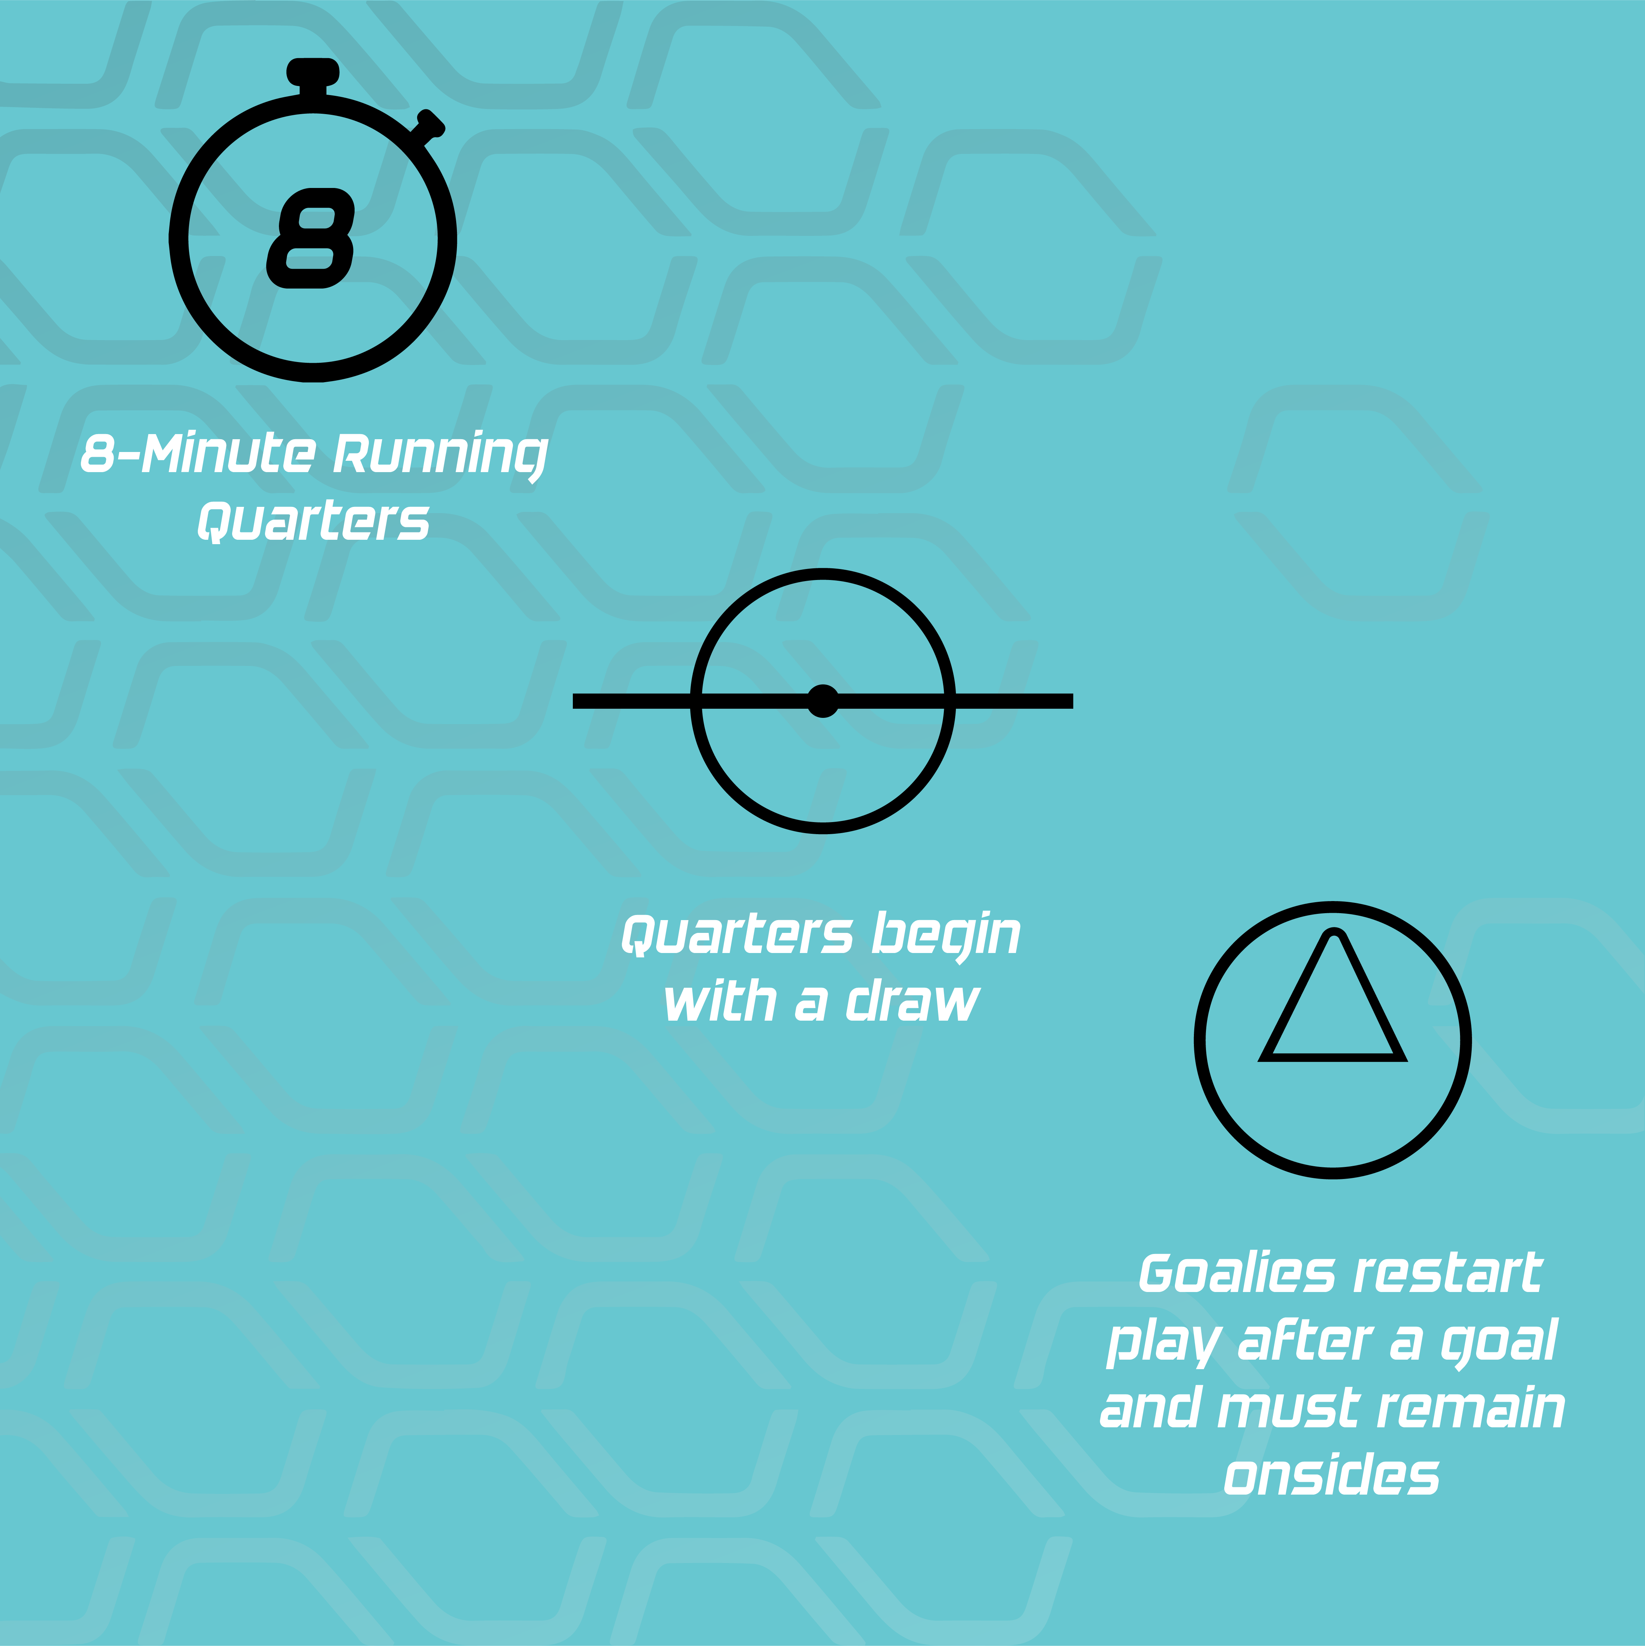
WL SIXES
INFOGRAPHICS

Slide 15
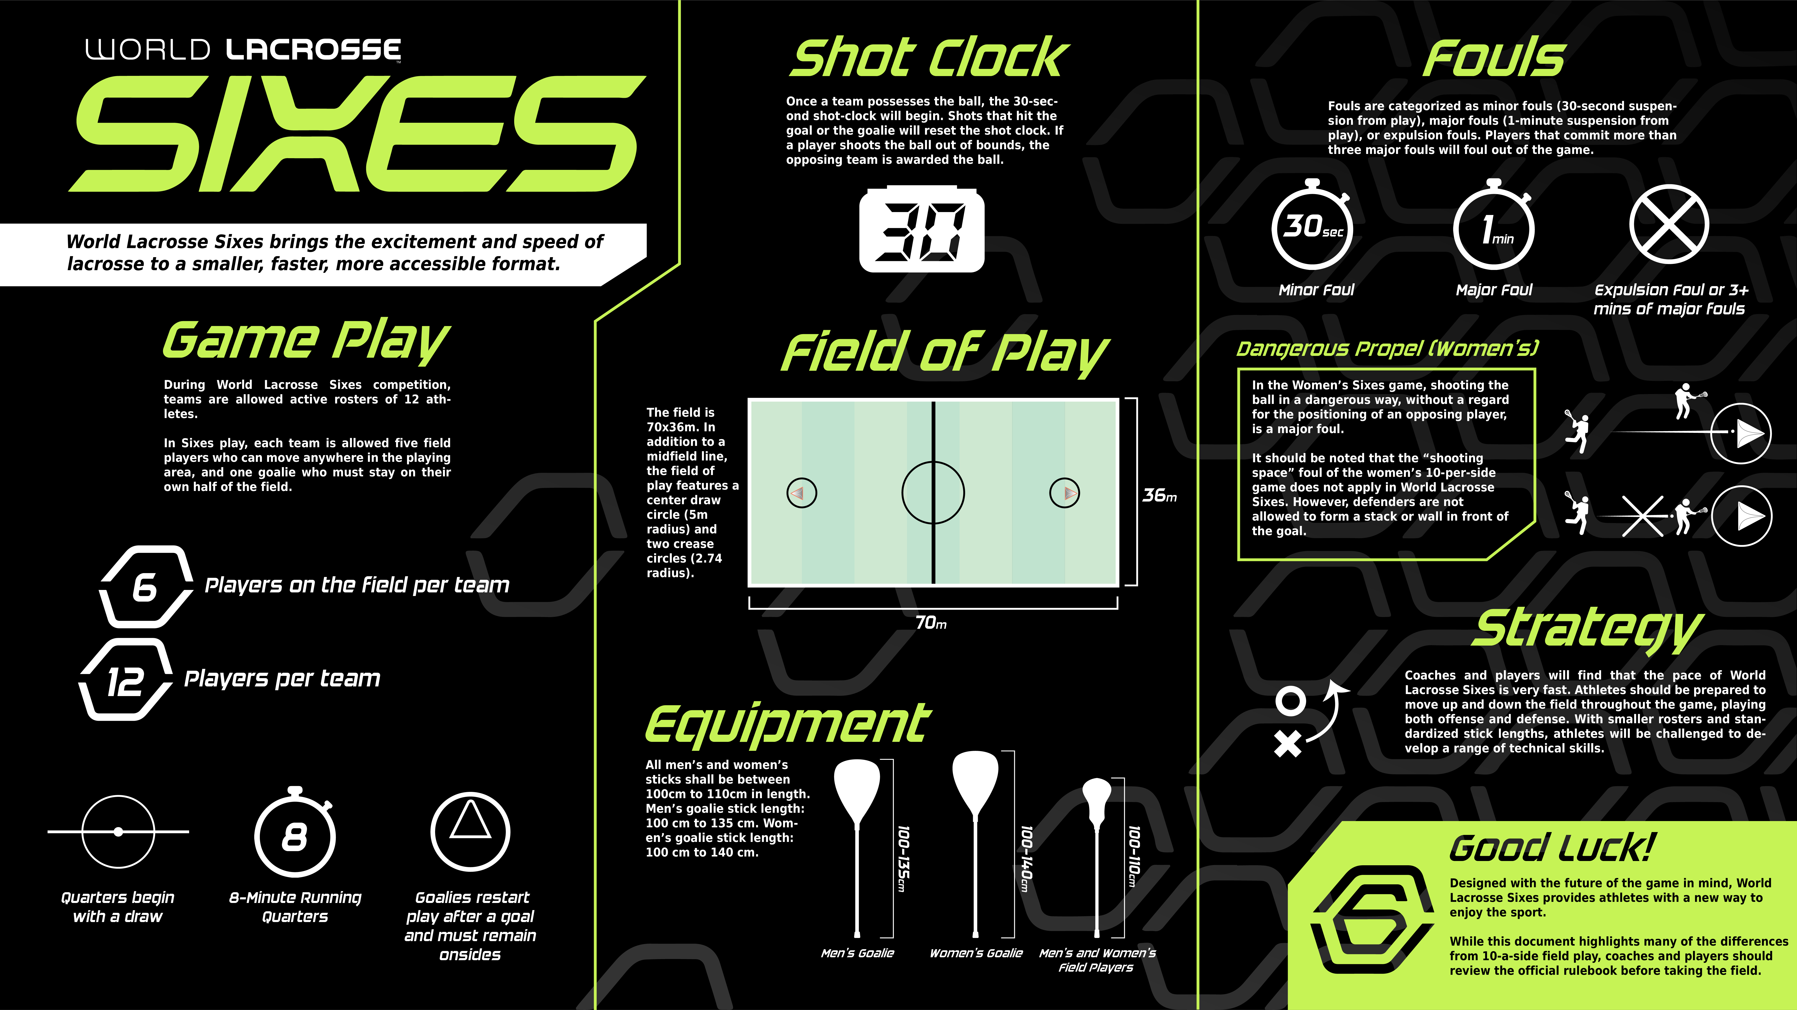
WL SIXES
INFOGRAPHICS

Slide 16
WL SIXES SOCIAL ACTIVATION ASSETS
WL SIXES LOGOS
https://worldlacrosse.sport/sixes/sixes-brand-communications/
AVATARS
https://bit.ly/3vQRbvK
FRAMES
https://bit.ly/3vQRbvK
INFOGRAPHICS
https://worldlacrosse.sport/sixes/sixes-resources/
ADDITIONAL QUESTIONS?
Please email amastera@worldlacrosse.sport

